Slide 1
THE EFFECT OF LAND DEVELOPMENT ON STREAM ECOSYSTEM HEALTH IN THE MILL BROOK PRESERVE IN NEW PALTZ, NY, USA
HOPE NITZA
MENTORS: DR. NEIL BETTEZ, MARTHA CHEO

Slide 2
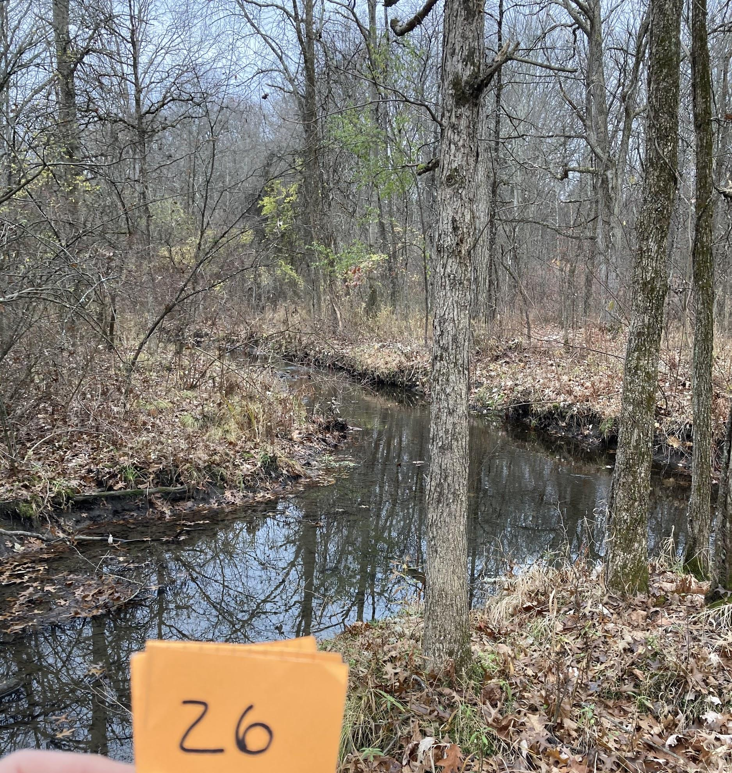
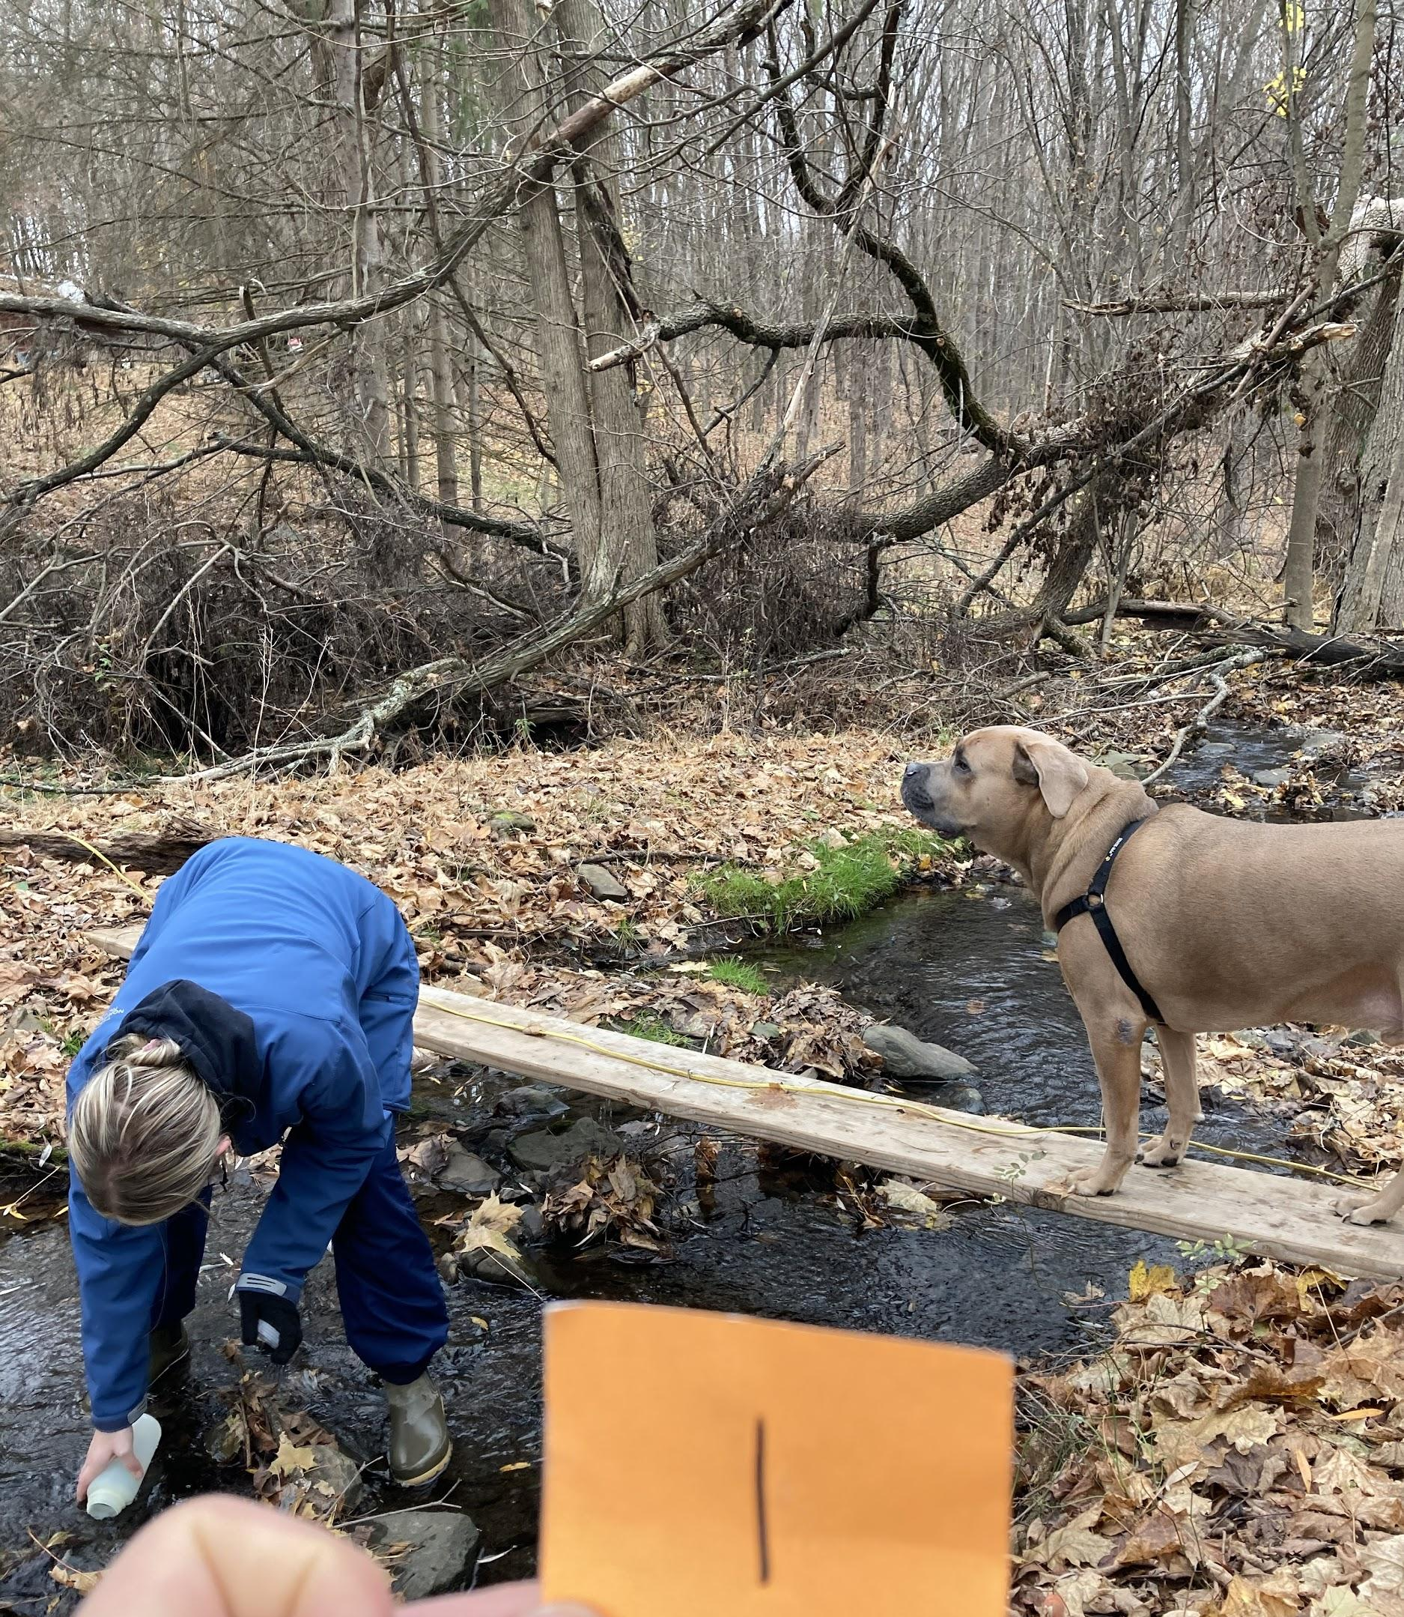
INTRODUCTION
The Mill Brook Preserve:
134-acre nature
Preserve in New Paltz
Conserve biodiversity, recreation, education
Tributaries are one of the last undeveloped areas in New Paltz

Slide 3
INTRODUCTION
Land Development
Impacts on stream ecosystem health are growing in severity and expansiveness

Slide 4
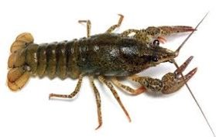
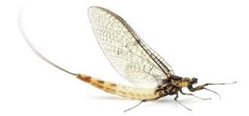
INTRODUCTION
Macroinvertebrates:
Key indicator species of stream ecosystem health
Mayfly facts: 30 interesting facts you will need for your project. (2021, January 15). Retrieved February 03, 2021, from https://factslegend.org/30-fascinating-mayfly-facts-shouldnt-miss/

Slide 5
REVIEW OF LITERATURE
Degradation of water quality in the Mill Brook Preserve as surrounding land development increased
(1) Cheo, Martha. 2004. Assessment of the Mill Brook Stream in the Town of New Paltz, New York. Village of New Paltz EnCC and Hudson Basin River Watch.
(5) Stolzenburg, AICP, Nan, and Don Meltz, AICP. The Mill Brook Preserve A Plan for Its Creation and Management. (2014, August). Retrieved January 07, 2021, from https://www.townofnewpaltz.org/sites/g/files/vyhlif3541/f/file/file/mill_brook_preserve_management_plan-final_08.28.2014_01.pdf
(7) Zeoli, Frank. 2007. Benthic Macroinvertebrate Analysis: Mill Brook Stream, New Paltz, NY. (Fieldwork for Biology 494). State University of New York at New Paltz, New Paltz, NY.
Notes:
over the past 20 years

Slide 6
REVIEW OF LITERATURE
Stream Ecosystem Health:
Changes in conjunction with surrounding land use impact
Barometer of land use pressures on a watershed
(4) Stainbrook, K.M., Limburg, K.E., Daniels, R.A. et al. Long-term changes in ecosystem health of two Hudson Valley watersheds, New York, USA, 1936–2001. Hydrobiologia 571, 313–327 (2006). https://doi.org/10.1007/s10750-006-0254-5
(6) Landers, M. N., Geological Survey (U.S.). (2002). Does land use affect our streams?: a watershed example from Gwinnett County, Georgia, 1998-2001. [Reston, Va.]: U.S. Dept. of the Interior, U.S. Geological Survey.

Slide 7
REVIEW OF LITERATURE
Land development can alter the species composition and distribution of macroinvertebrates
Prime indicators of stream ecosystem health
(2) Limburg, K., & Schmidt, R. (1990). Patterns of Fish Spawning in Hudson River Tributaries: Response to an Urban Gradient? Ecology, 71(4), 1238-1245. doi:10.2307/1938260
(3) Wallace, J. B., & Webster, J. R. (1996). The role of macroinvertebrates in stream ecosystem function. Annual review of entomology, 41, 115–139. https://doi.org/10.1146/annurev.en.41.010196.000555

Slide 8
HYPOTHESIS
There is a negative correlation between the percent of developed land in the watersheds of the Mill Brook Preserve and their stream ecosystem health

Slide 9
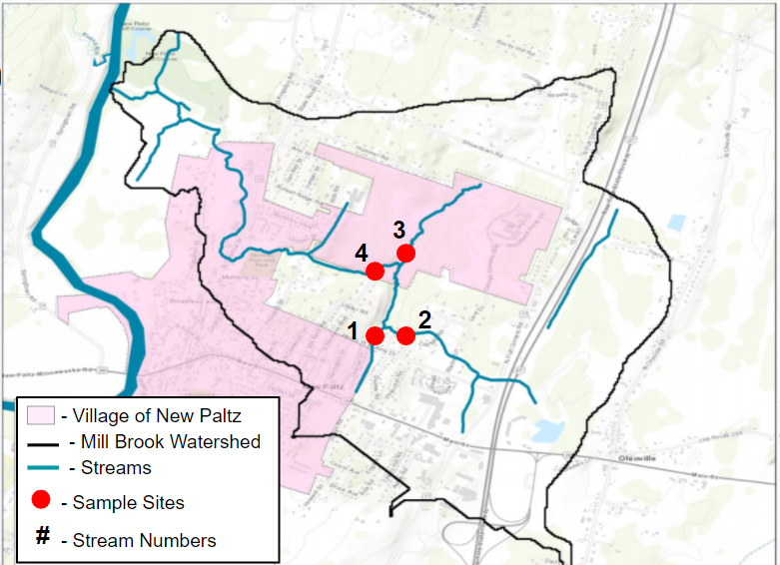
METHODOLOGY
3
4
1
2

Slide 10
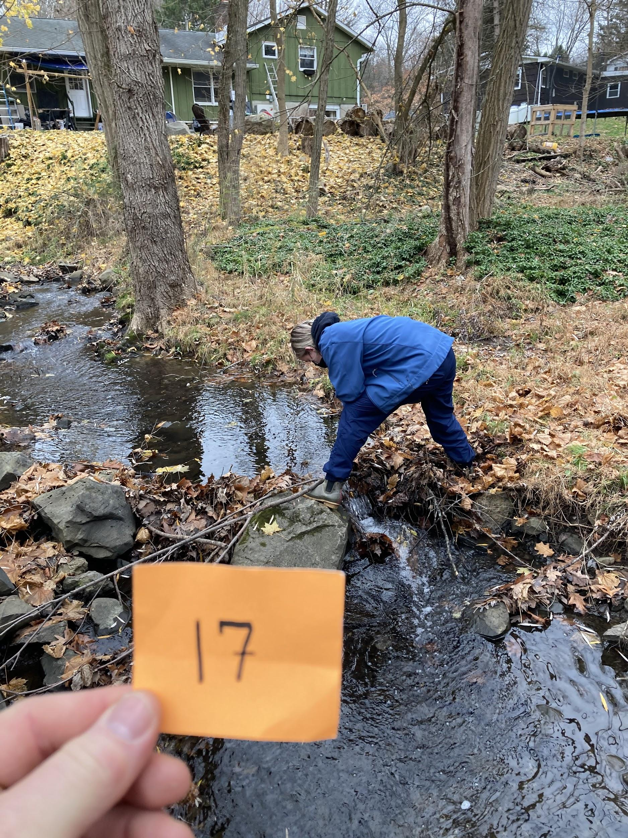
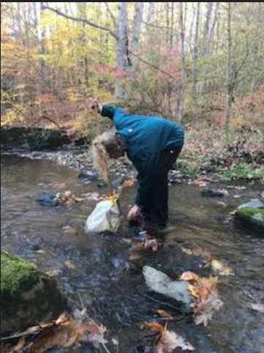
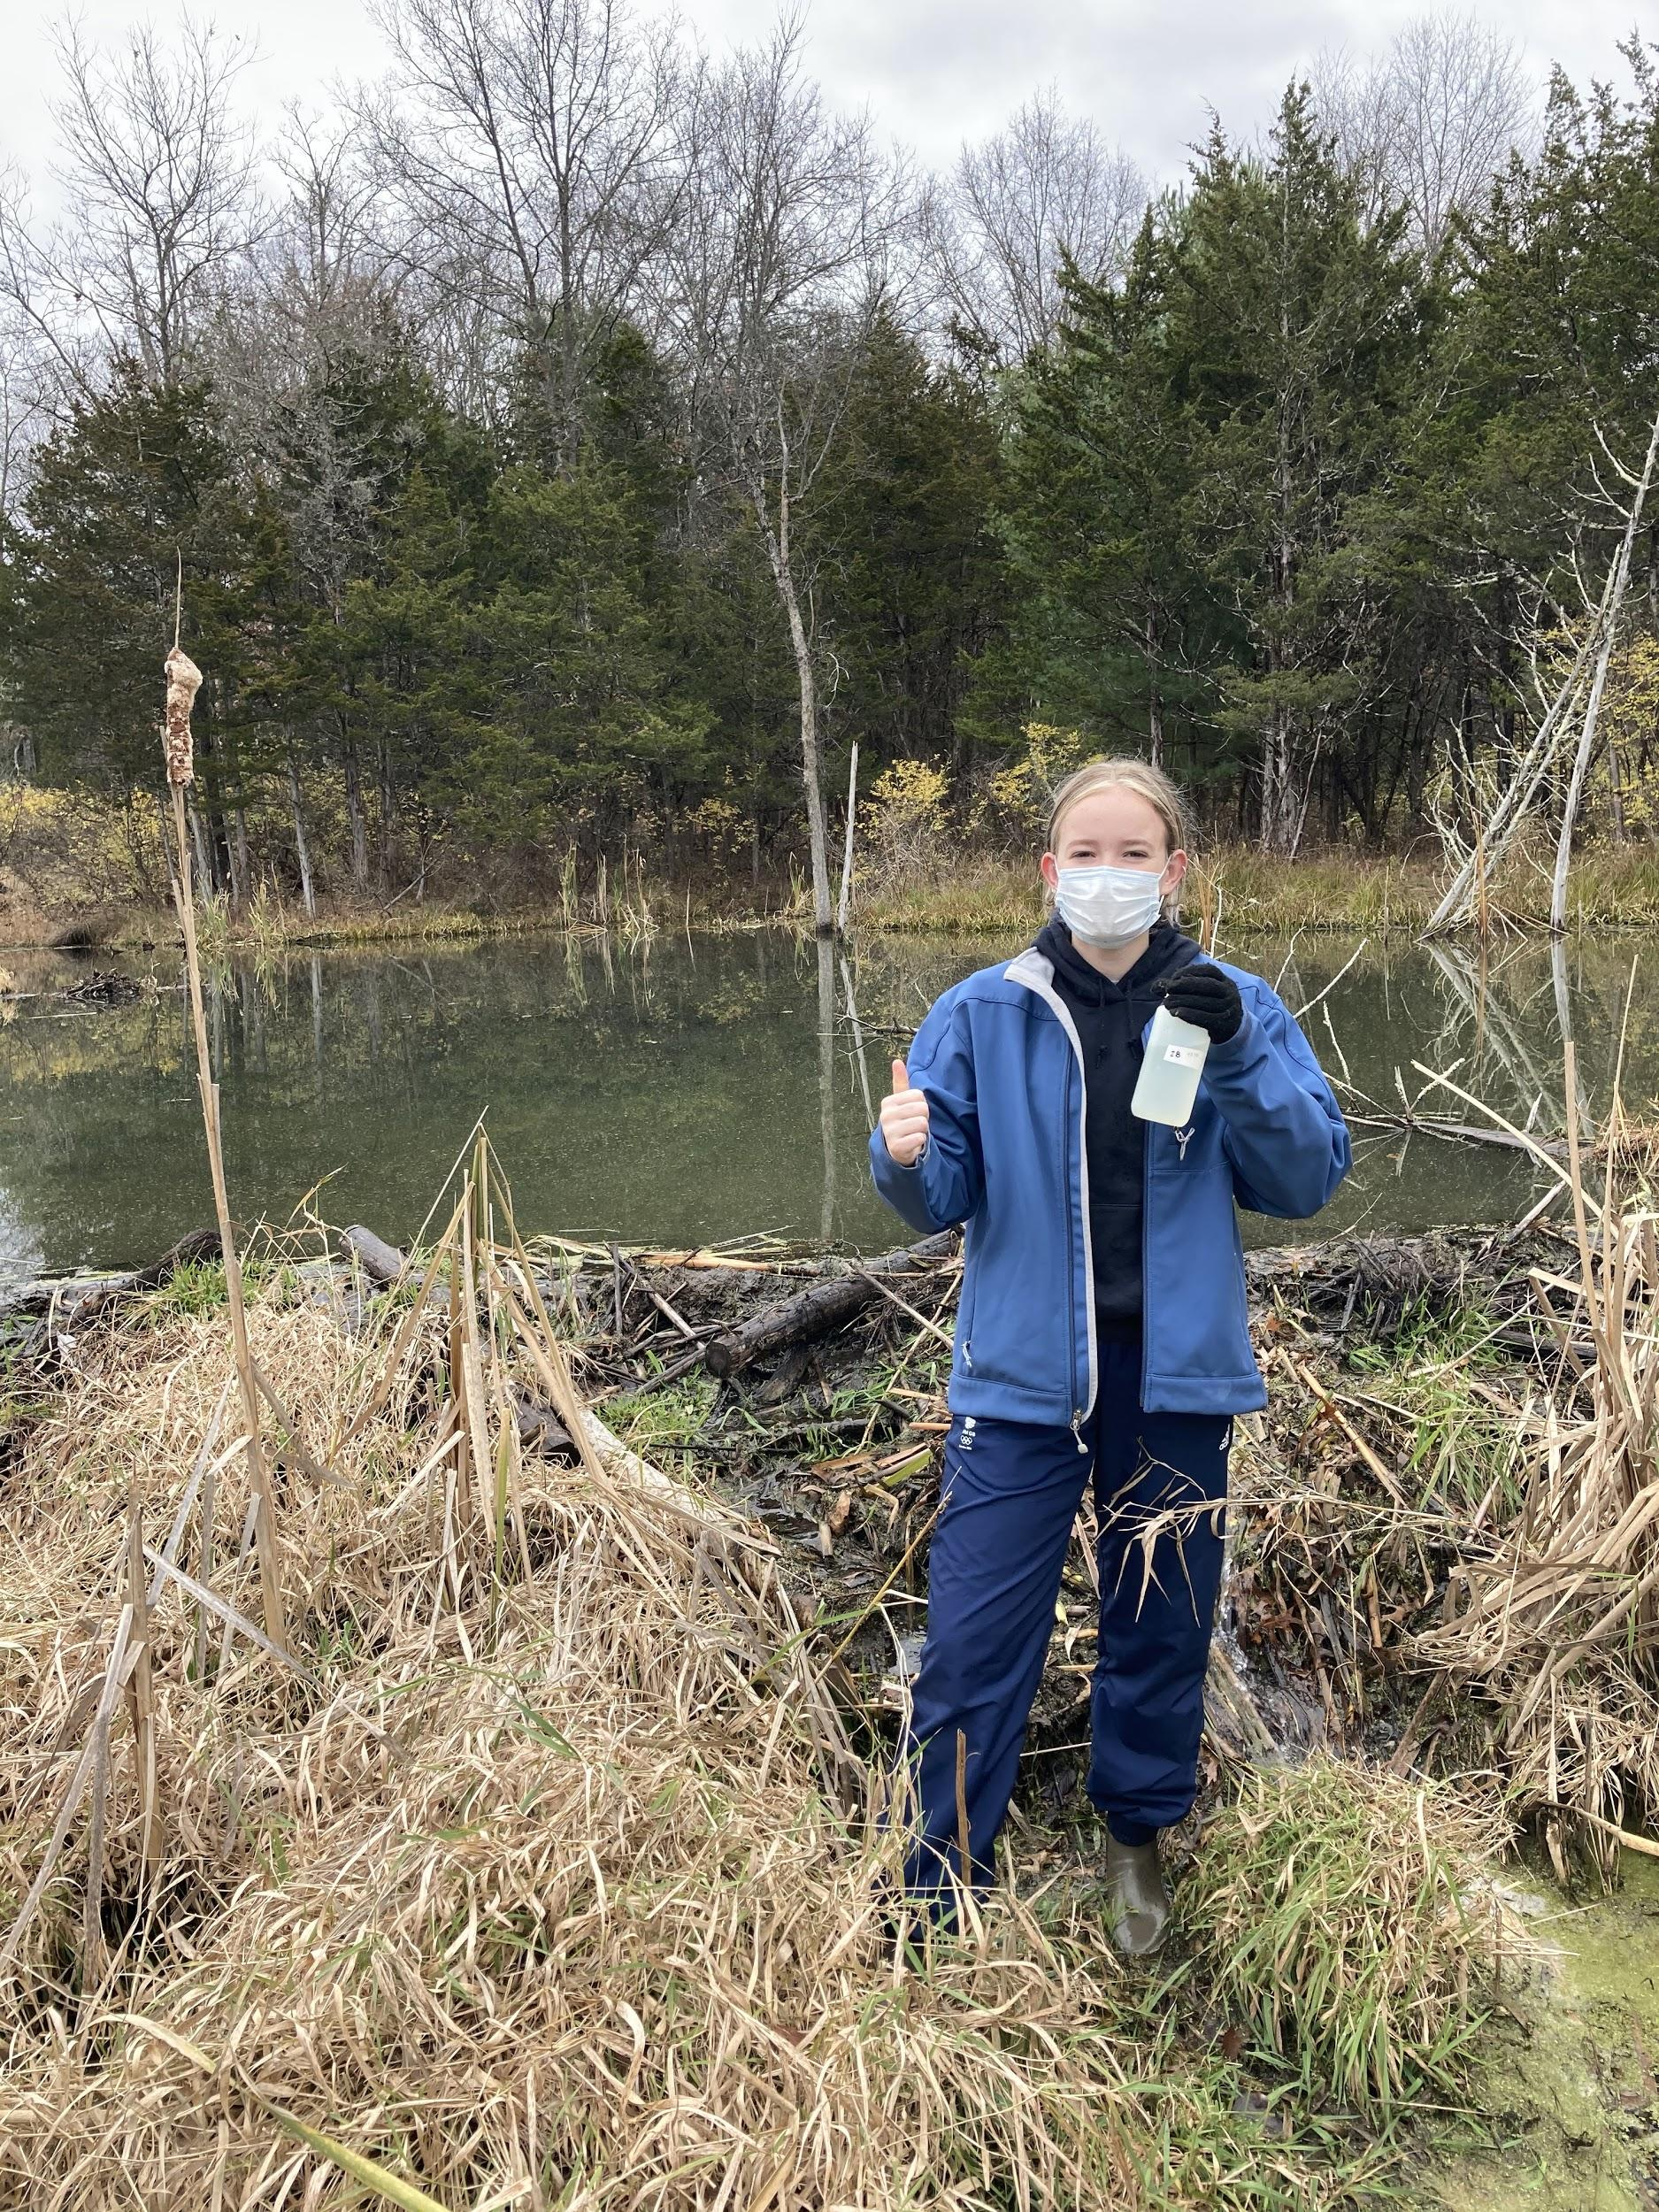
METHODOLOGY
Field study: Macroinvertebrates and Habitat Assessment
1 round per site during September, 2020

Slide 11
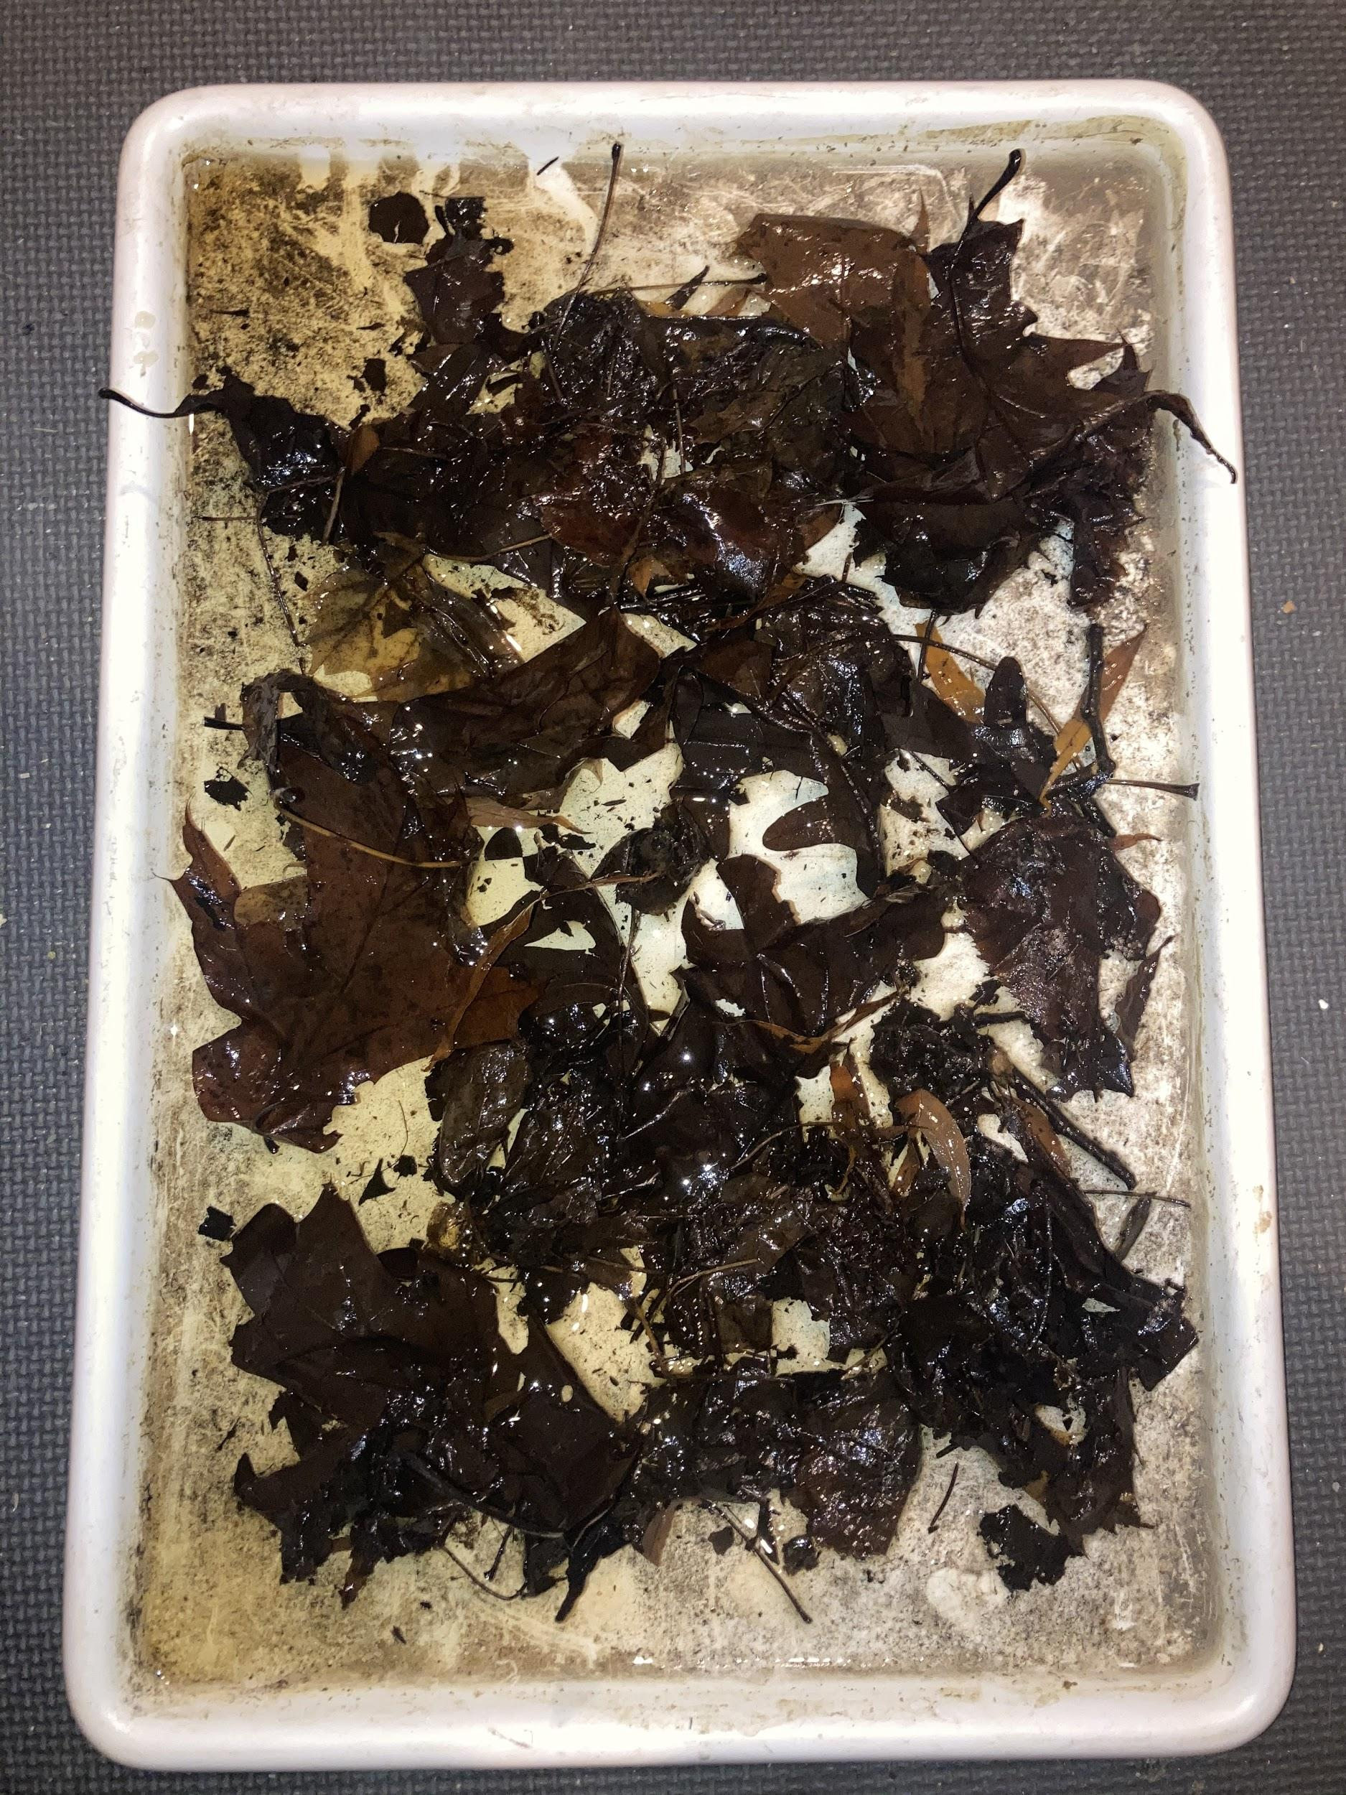
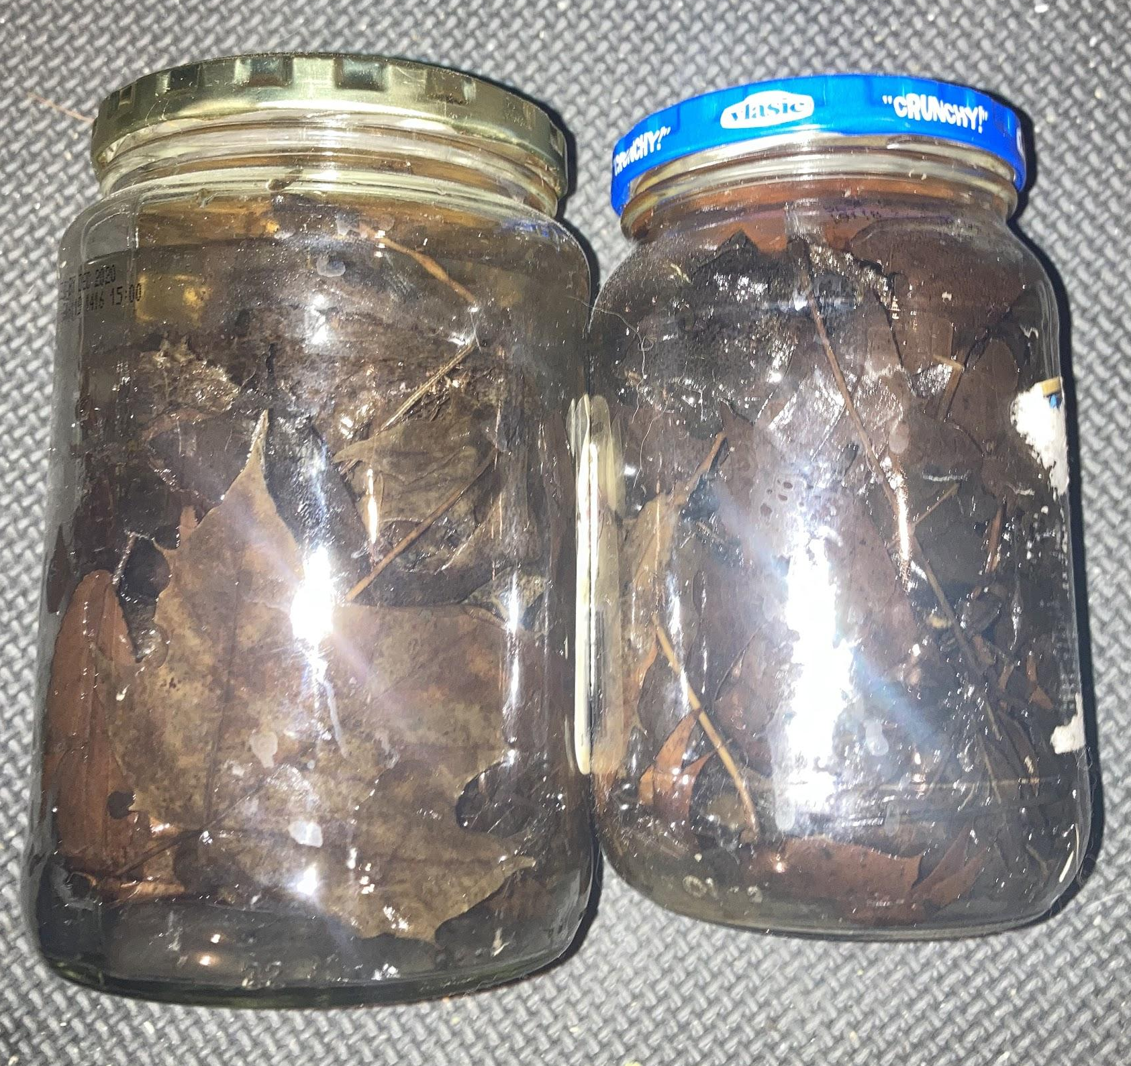
METHODOLOGY

Slide 12
METHODOLOGY
Biodiversity indices calculated for each sample:
EPT Richness Estimate
Mayfly, caddisfly, and stonefly count
Percent Model Affinity
Compares sample to a model community
Major Group Biotic Index
Calculated using each order’s pollution tolerance values

Slide 13
METHODOLOGY

Slide 14
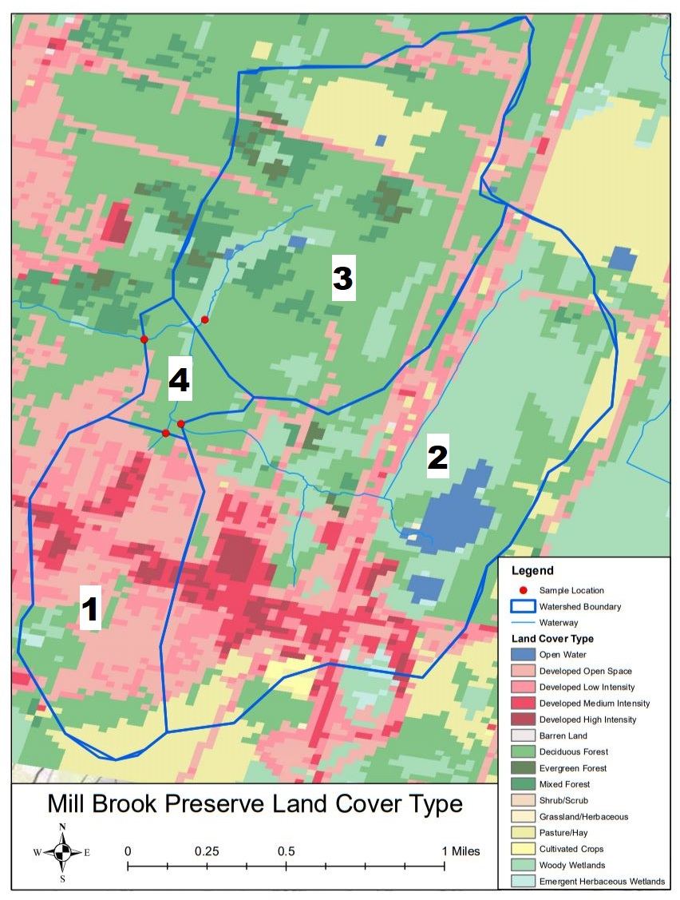
METHODOLOGY

Slide 15
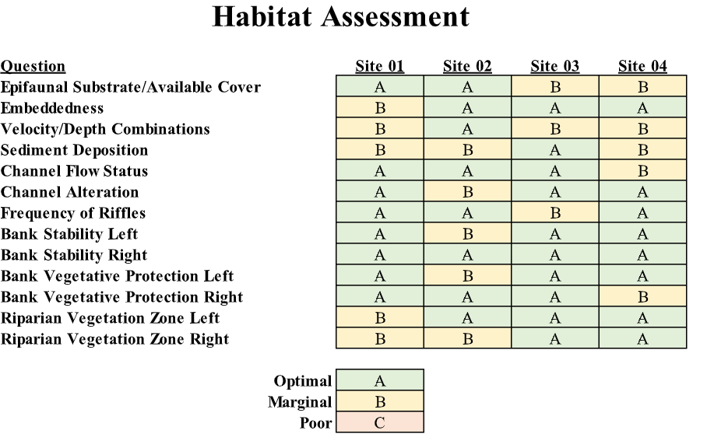
RESULTS
Notes:
Indicators of impact

Slide 16
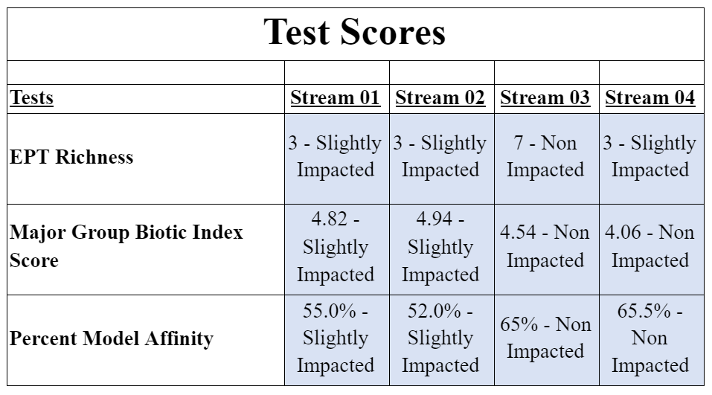
RESULTS Biodiversity Indices

Slide 17
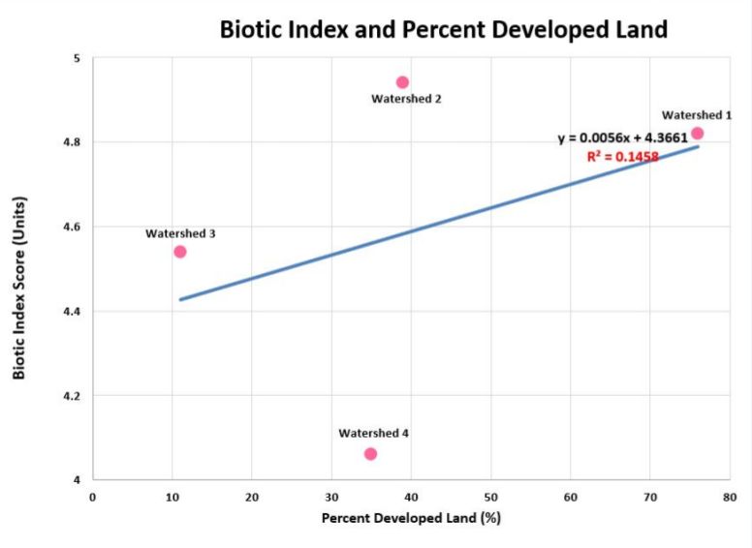
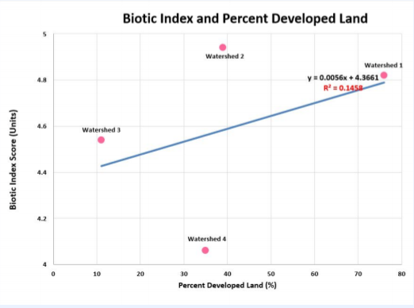
RESULTS

Slide 18
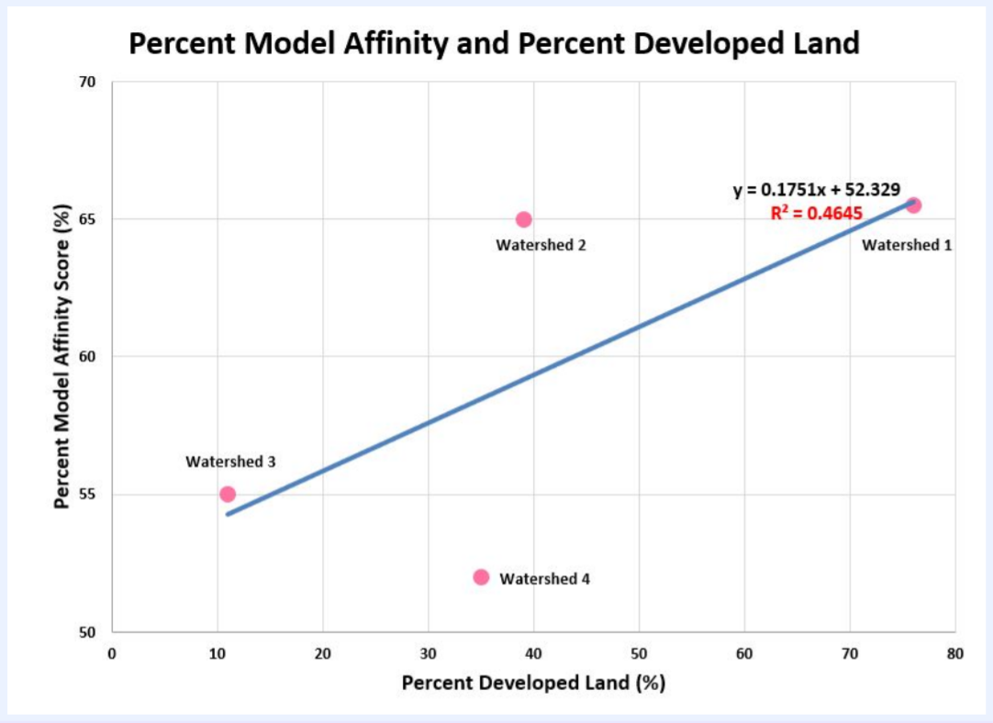
RESULTS

Slide 19
DISCUSSION
Habitat Assessment
Stream 3 - highest habitat quality
Watershed of stream 3 - lowest percent of developed land (11%)
Indices
2 streams with lowest % of developed land are least impacted
2 streams with highest % of developed land are most impacted

Slide 20
DISCUSSION
Biotic Index and % Developed Land
R² = 0.146
Weak relationship
% Model Affinity and % Developed Land
R² = 0.383
Moderate relationship
Negative relationship between percent developed land and stream ecosystem health

Slide 21
DISCUSSION
Stream 4 is an anomaly:
2 Biodiversity scores indicate:
it is less impacted than stream 3
has a higher percentage of developed land than stream 3
Notes:
Differentiate between location and watershed 4
Data from stream 4 was anomaly, which represents the combined watershed
Note the anomaly and why it could have happened

Slide 22
CONCLUSIONS
Negative correlation between the percent of developed land of a watershed and the impact on the stream ecosystem health
Findings support the hypothesis
More research needed to determine cause of the anomaly
Notes:
Examined the relationship between land development and stream ecosystem health
What could come from the anomaly in the future

Slide 23
REFERENCES
(1) Cheo, Martha. 2004. Assessment of the Mill Brook Stream in the Town of New Paltz, New York. Village of New Paltz EnCC and Hudson Basin River Watch.
(2) Limburg, K., & Schmidt, R. (1990). Patterns of Fish Spawning in Hudson River Tributaries: Response to an Urban Gradient? Ecology, 71(4), 1238-1245. doi:10.2307/1938260
(3) Wallace, J. B., & Webster, J. R. (1996). The role of macroinvertebrates in stream ecosystem function. Annual review of entomology, 41, 115–139. https://doi.org/10.1146/annurev.en.41.010196.000555
(4) Stainbrook, K.M., Limburg, K.E., Daniels, R.A. et al. Long-term changes in ecosystem health of two Hudson Valley watersheds, New York, USA, 1936–2001. Hydrobiologia 571, 313–327 (2006). https://doi.org/10.1007/s10750-006-0254-5
(5) Stolzenburg, AICP, Nan, and Don Meltz, AICP. The Mill Brook Preserve A Plan for Its Creation and Management. (2014, August). Retrieved January 07, 2021, from https://www.townofnewpaltz.org/sites/g/files/vyhlif3541/f/file/file/mill_brook_preserve_management_plan-final_08.28.2014_01.pdf
(6) Landers, M. N., Geological Survey (U.S.). (2002). Does land use affect our streams?: a watershed example from Gwinnett County, Georgia, 1998-2001. [Reston, Va.]: U.S. Dept. of the Interior, U.S. Geological Survey.
(7) Zeoli, Frank. 2007. Benthic Macroinvertebrate Analysis: Mill Brook Stream, New Paltz, NY. (Fieldwork for Biology 494). State University of New York at New Paltz, New Paltz, NY.
(8) USA NLCD Land Cover. (2019, June 5). ArcGIS Online.
(9) Behar, S., & Cheo, M. (2004). Hudson Basin River Watch Guidance Document: Helping to coordinate monitoring of freshwater wadeable rivers throughout the watershed. Retrieved January 07, 2021, from http://www.communityscience.org/wp-content/uploads/2017/05/HBRWGD04.pdf

